Slide 1
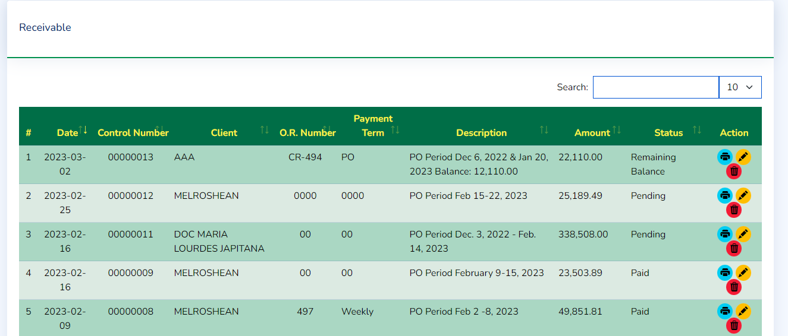
Amount will be change to Total Due
Add next to Total Due the Remaining Balance
Status remove the Remaining Balance

Slide 2
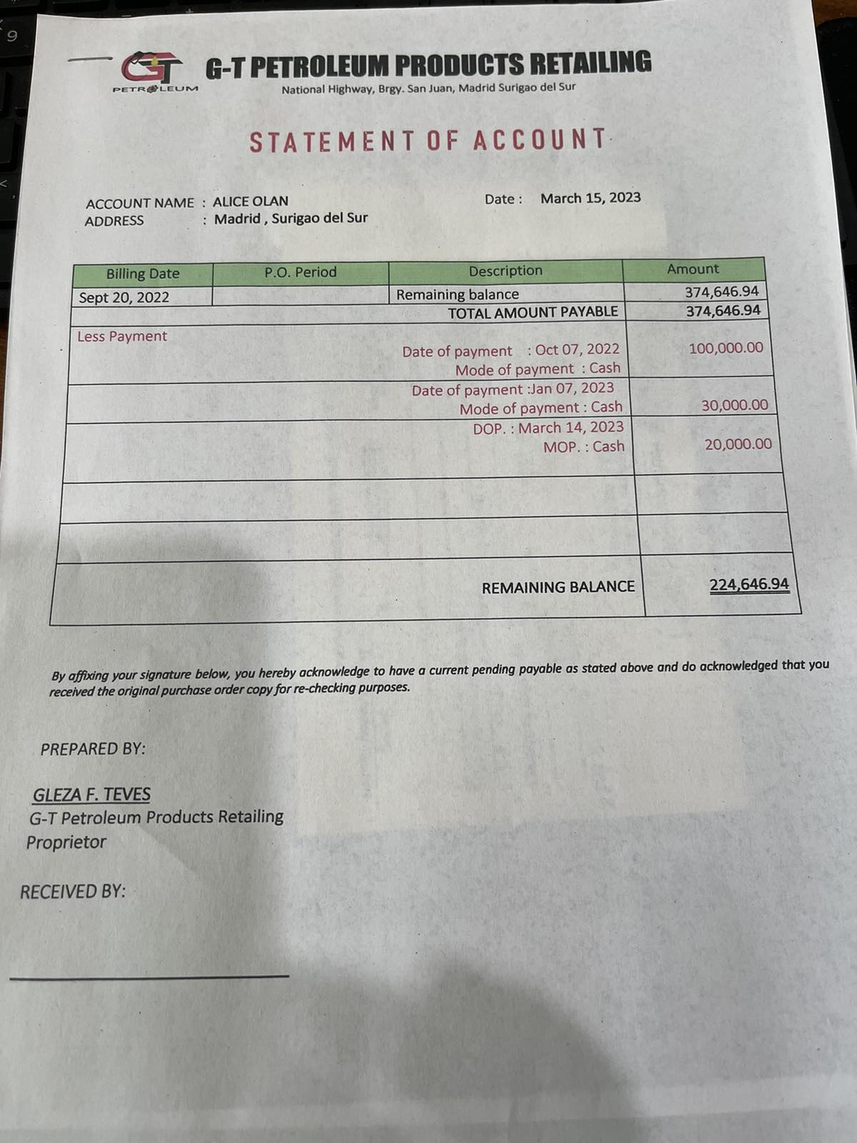
Statement of Account
Input : Date of Payment
Mode of Payment
Payment Reference
Amount
Must be in a new table receivable_payment_table.
Remaining balance will be updated on every entry or deletion.

